Slide 1
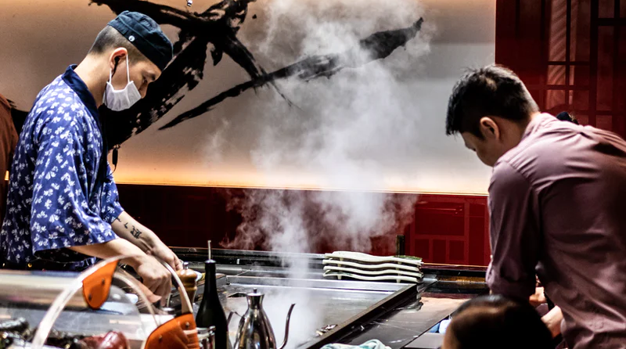

Bringing Teppanyaki to Life
Team #47
Notes:
Title sldie
Covid 19 is changing our world and forces many small businesses like Margaret’s to adapte to our new lives.. Today, we’re going to be talking how about we’re brining teppanyaki to life in plan for surviving and thriving in this pandemic..

Slide 2
Title slide
3 MINUTE for my part without mission statement
Good afternoon everyone,
My name is Kevin we’re from team 47
As we all know, Covid 19 is changing our world and forces many small businesses like Margaret’s to adapt to our new lives.. Today, we’re going to be talking how about we’re bringing teppanyaki to life in order to survive and thrive in this pandemic..

Slide 3
Objectives
Passionate about experience-driven teppanyaki, elevated through our digital presence, we aim to improve our respective communities through our class of trade.
Increase delivery/pickup services
SHOW GRAPH OF DELIVERY
Prioritize team morale
SHOW VIRTUAL HAPPY HOURS PIC
Develop a diversified revenue portfolio
SHOW DIVERSIFIED PORTFOLIO

Slide 4
Strategies
Develop a marketing plan
Digital Transformation
Rebranding
Increase delivery/pickup services by
Prioritize team morale by
Virtual happy hours
Education for new career path
Salary increase / Hazard pay
Private chef / Omakase
Flexibility for dine-in / takeout
Online presence (Ordering)
Develop a diversified revenue portfolio
To achieve those objectives, we’ve developed unique strategies.
To increase our delivery and pickup services, we developed a new marketing plan, created a simple website for live grills, stripped down our menu to what we do best, and reintroduce our brand as a high-quality, premium hibachi.
In the case of team building, we raised the salaries of our employees, created new ways of connection through online happy hours, as well as ensuring that all members of our team can arrive and work safely.
Lastly, to develop a diversified revenue portfolio, I’m pleased to introduce the idea of Omakase. Omakase is when our trained and experience chefs arrive at your home to bring the hibachi experience to you.

Slide 5
Phase 1 – Pickup and Delivery
Phase 1
Phase 2
Phase 3
Pickup / delivery
Omakase
Dine in
Pick-Up / Delivery
Digital Experience
Live Grill
Storytelling
Active – Tracking
IMPACT GOES HERE
Phase 1 is delicated to pickup and delivery. Phase two is for Omakase and phase three is for dining in.
In order to increase our pickup and delivery demand, we’ve created a website for online ordering, live grill watching, and live tracking for your hibachi.
We’ve added blogs to highlight the stories of our chefs, waiters, and hosts to bring transparency to our customers, hoping for their trust.
Based on our research, THE IMPACT GOES HERE
With the cash flow generated from phase 1, we want to look for an alternative profit stream in phase 2. Lin will introduce you to Omakase

Slide 6



Digital Transformation
Private-Chef
Re-Branding
Objectives
KPIs
1. Develop a marketing plan to drive increase usage of delivery and curbside pickup services.
Profit post COVID-19
Number of Delivery
2. Identify market potential in home dining experiences to develop diversified revenue portfolio.
Number of Omakase
Number of Reservations
3. Facilitate employee training and education on COVID-19 health regulations, prioritize team morale, and explore new career paths.
Number of Employees
Restaurant Penetration
Phase 1
Phase 2
Phase 3
Delivery & Pick-up
Omakase
Reopening Plans
Aug - Sep 2020
Fall 2020
Fall 2020 & Beyond
Rebrand for quality and experience first. Simplified menu optimized for delivery and curbside pickup. Provide chefs with training on omakase service.
We bring THG to your home through our new private teppan-chef home service. Celebrate your special occasions at the comfort of your home.
Elevated dining experience with private rooms available and compliance with health regulations post COVID-19.
Notes:
Slide 1: What are our objectives -
Increase delivery and pickup services:
Digital transformation
Rebranding
Storytelling
Develop a diversified revenue portfolio to minimize risk and maximize profits
Private-Chef
Prioritize team morale and exploring new career paths.
Education and training on COVID-19
Slide 2: Strategies (Phases)
Our plan contains 3 strategies:
Delivery and Pickup
Omakase
Safely Reopening

Slide 7
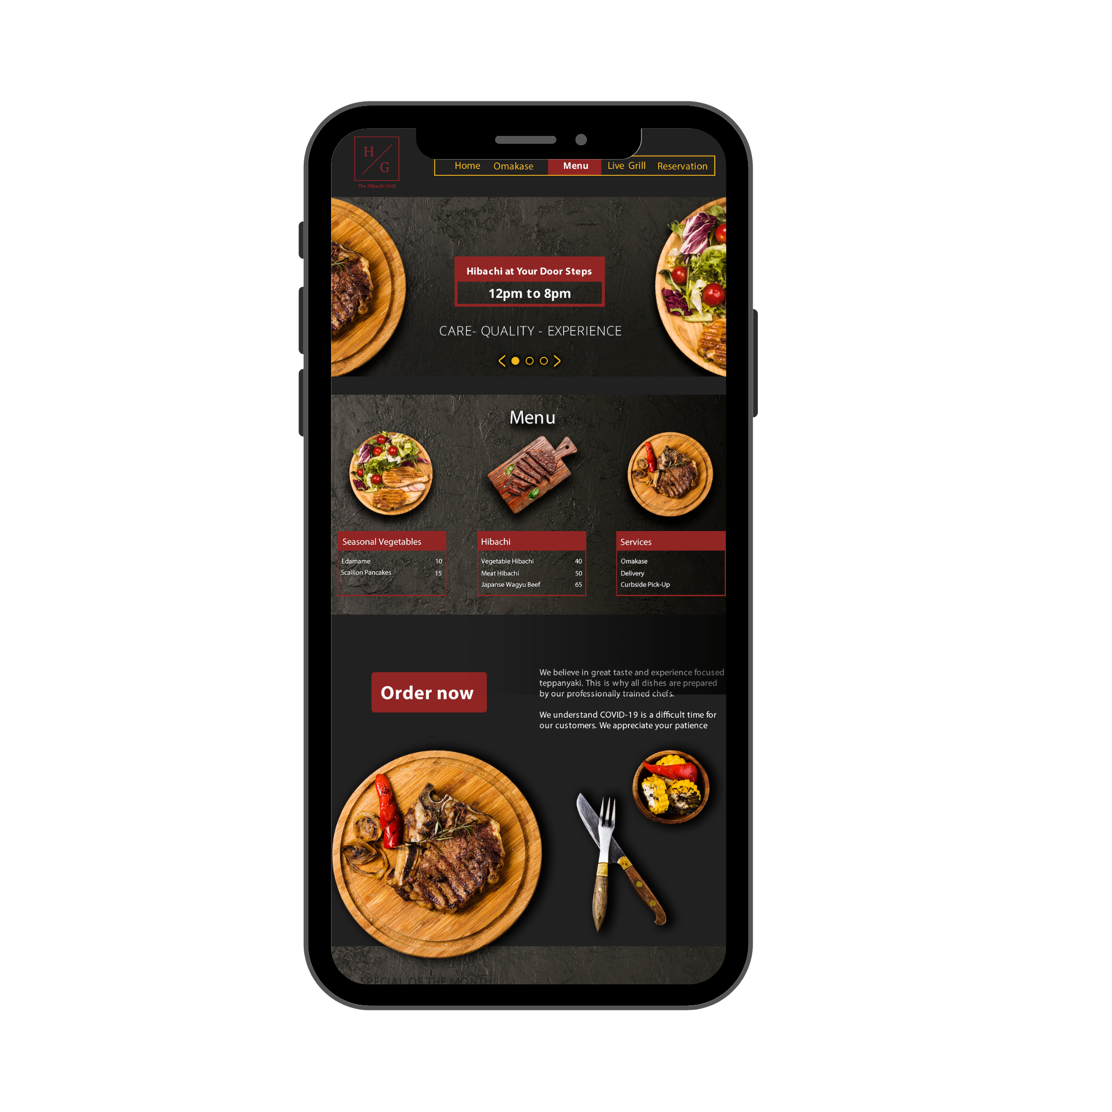






Enhanced digital content appeals to consumer needs and promotes an experience-driven teppanyaki brand.
Delivery & Pick-Up
Phase 1
Phase 2 + 3
Digital Experience
The
Hibachi
Grill
Reservation
Launch new website with CRM functions to improve marketing communication.
Place a reservation when dine-in option is available for phase 3.
Our Mission
Live Grill
Omakase
Watch your food being prepared from the moment it is ordered to the time it arrives within your home.
Passionate about experience-driven teppanyaki, elevated through our digital presence, we aim to improve our respective communities through our class of trade.
Enjoy personalized dishes prepared by our professionally trained teppanyaki chefs.
Pick-Up / Delivery
Storytelling
Pick what is the easiest for you. All-in-one website to place an order whether it is pick-up or delivery.
Highlight the stories of our chefs, waiters, and hosts and their culinary journey.
Notes:
Words shorter - Only phase 1
Move mission elsewhere
Move storytelling to phase 1
Financial Impact (Slide)
Wiht the cash flow generated, we want to look for alternative profit stream -> private chef (next slide)
Digital ttrnasformation will improve pick up and delivery, + other features here

Slide 8
Private Chef Service: Market Description and Opportunity
Omakase
Households in Philadelphia
Total of 600,000 households in Philadelphia
(Source: U.S. Census)
Median monthly household income: $2700 after-tax.
Product caters to the top 50% of the city households. (Avg. price $400)
Market penetration goal: 0.5% to 1%
Projected annual profit at goal: $187k to $374k.
See Appendix for detailed cost structure of the product.
0.01%
300
300k
50%
Household income in the top 50%
Private chef bookings needed to break even
Notes:
The market for private chefs is attractive - There is demand and no comps in philly
Private chefs bring value to all stakeholders, and to us.
Consumer behavior are shifting to favor private home services like private chefs due to covid.
These is our targeted consumer segment profile.
This is how we are implementing our private chef solution
Based on consumer needs, and potential market, and consumer targets, this is we came to omakase + it is financially feasible.
With cash flow generated, alternative revenue flow sources, look into private market
Households part.
Justification of demand
Add competitors - Not compeltely new
Private Chef services are valuable to all stakeholders
Value Prop
This is our go-to market strategy
3 Slides ( Find more justification for each)
Households in Philly
Value Prop
Go To Market Strategy
Omakase - can charge higher price for meal, use finest ingredients + skills, easier for them to plan food costs when purchasing

Slide 9
Value Proposition
Consumers: Celebrate their special occasions and experience authentic teppanyaki at the comfort of their home.
Chefs: Create employment opportunities, paired with comprehensive training with stipend, and competitive salary.
THG: Reinforce our mission of delivering experience-driven teppanyaki while generating positive cash flow.

Slide 10
Go-To-Market Strategy
1
Provide professional training for chefs on Japanese etiquette, culture, history, and home cuisines.
2
Obtain certifications including Pennsylvania Food Safety Training, Pennsylvania Food Handler, and Personal Certified Chef.
3
Leverage small business ad grants to advertise Omakase on Facebook, Instagram, and Google Search, as well as private chefs booking sites.

Slide 11


Mid-career professionals are seeking new at-home experiences
Profile
Most Used Social Media
Omakase
Age: 33 years
Location: Philadelphia
Job: Consultant
Gender: Female
What They Look For
Instagrammable
Ethical Sourcing
“I need new experiences that lets me see the bigger world, take new photos for my feed, and meet my friends for a nice meal.”
Personalized Service
Exclusivity
Purchase Behavior
$80
$40
$20
Notes:
Target Audience
COVID-19 Impact

Slide 12
COVID-19 Impact
Experiment new brands
More than 75% of consumers have experimented with a different shopping behavior during the crisis, including trying new brands. (Source: McKinsey)
Rise of at-home travel
Consumers are looking for ways to engage in travel-like experiences. Airbnb launched online experiences and famous landmarks now have virtual tours available.
Desire for social interactions
Search interest in “watching together” is up over 4X since early January. Consumers are seeking for new activities to do with their respective families. (Source: Google)

Slide 13
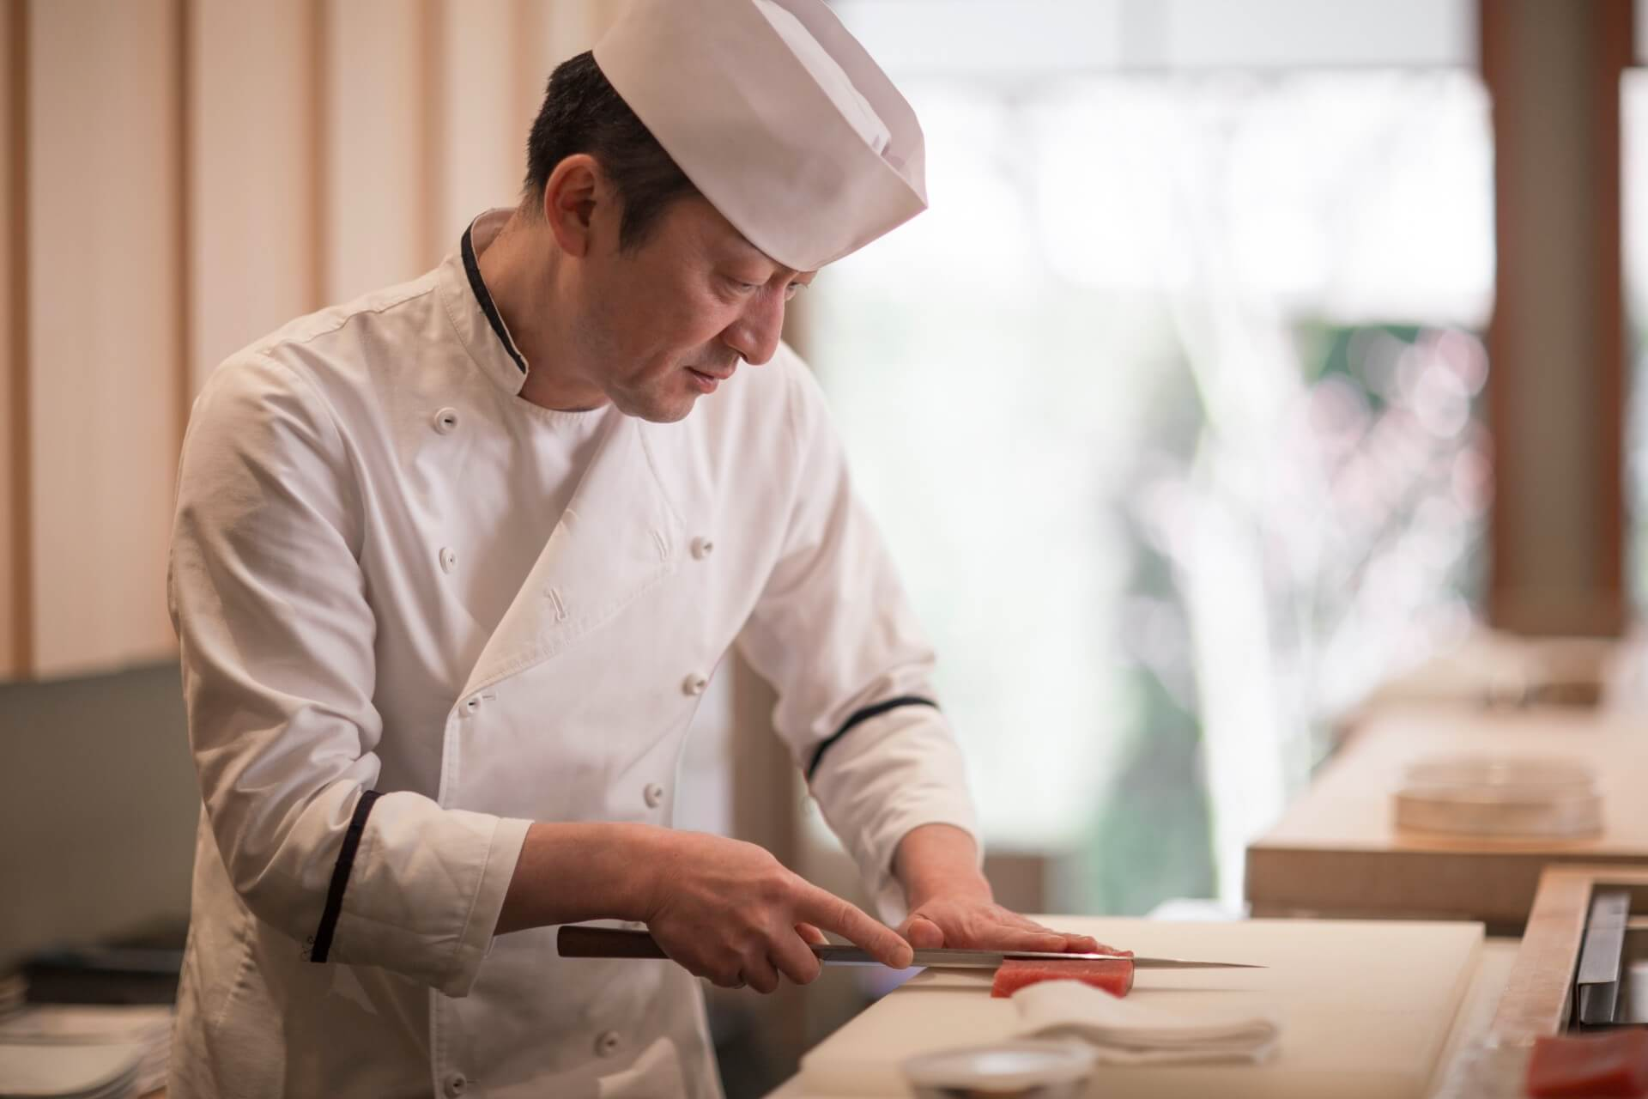
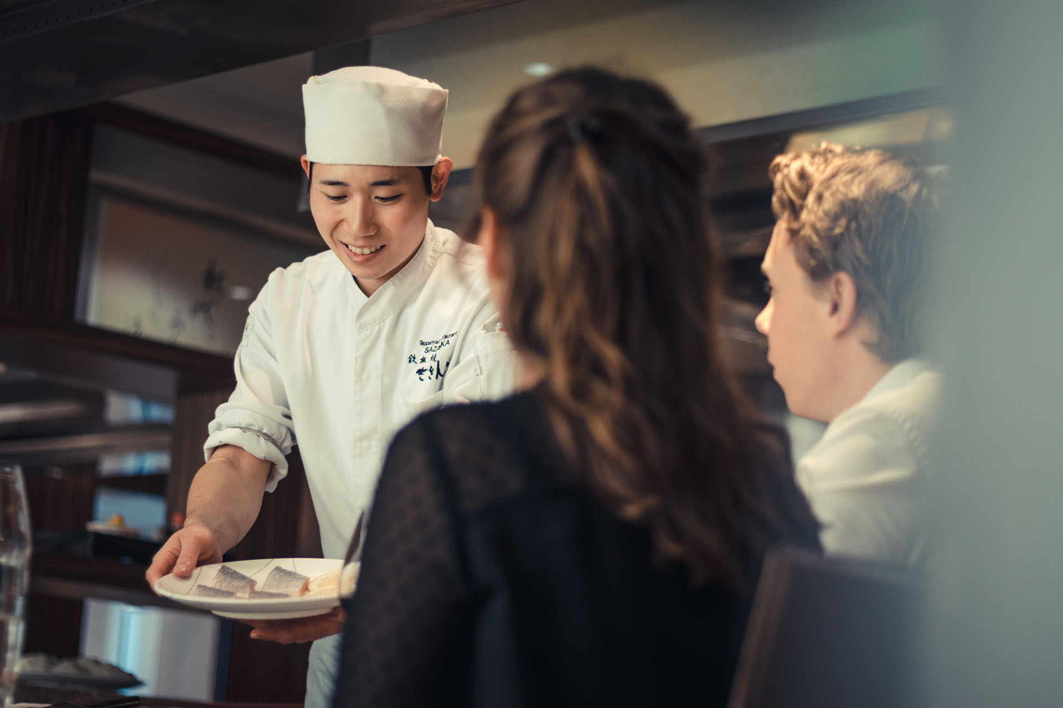
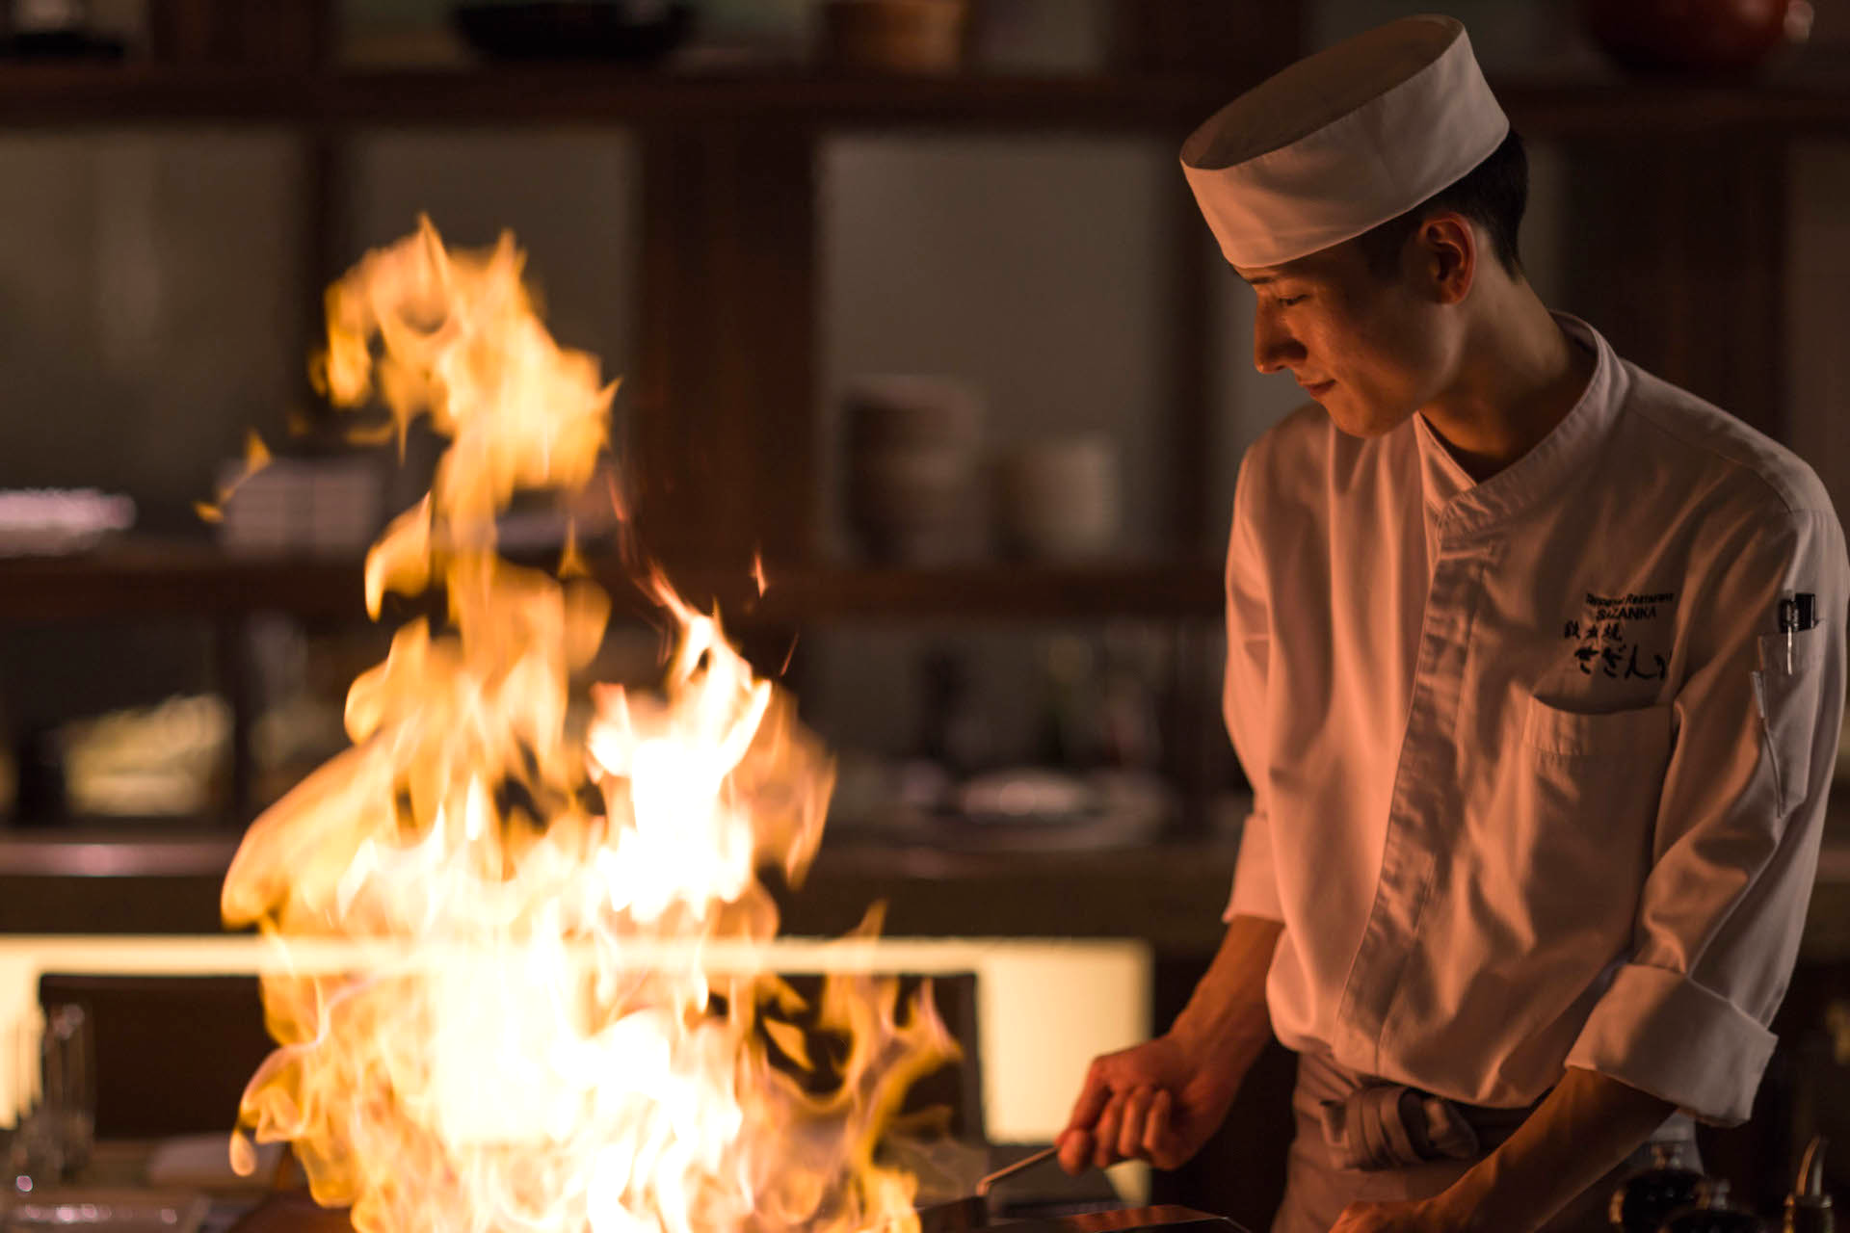
Omakase is a private teppanyaki chef service that brings Japan to your home
Omakase
Impact
130
avg. profit per omakase
8+
jobs retained
Quality
Care
Experience
With the freshest and most exclusive ingredients using bincho-zumi, a smokeless charcoal, we can bring the authentic teppanyaki experience to your home.
Our chefs are professionally trained in Japanese history, cuisine, and etiquette. We provide full-service from equipment, ingredients, to cleaning.
Celebrate your special occasions at home. Gather around expert teppanyaki chefs as they prepare dishes with flair and precision right before your eyes.
15,600
Monthly profit
See appendix for more detailed projected financials
Notes:
Leave short - Highlight specific things
Represent numbers in a graph if possible + Financial Impact
this is a new venture
Even after covid stops, we have sourcing from japan (we can explore either continue this service or move in store for premium)
This is omakase slide

Slide 15
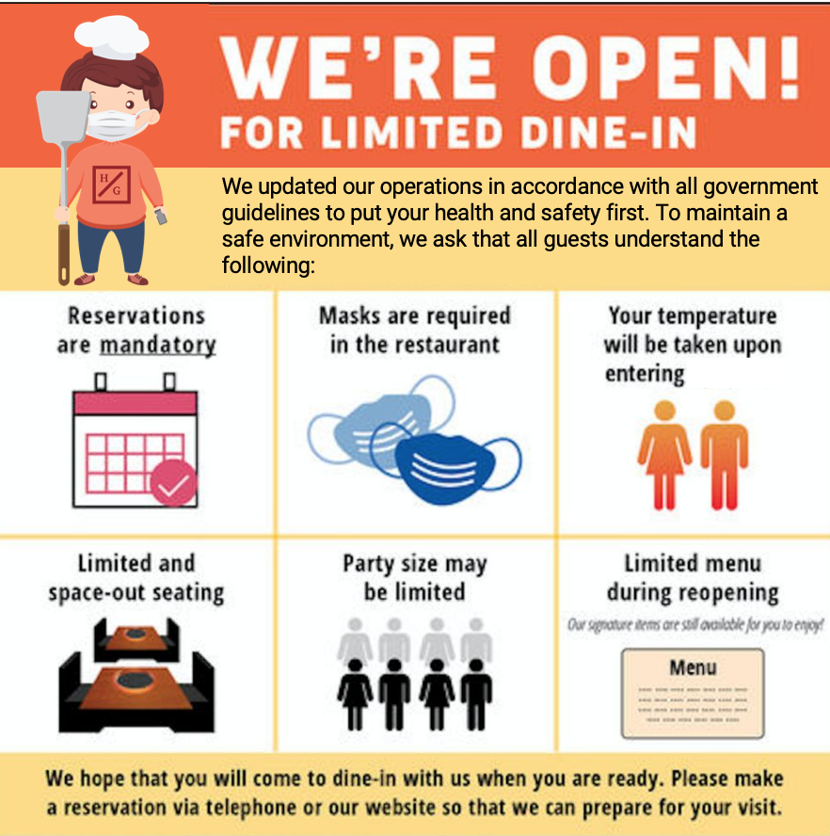

Restaurant reopening plans in accordance with all government regulations and with an emphasis on safety
Re-Opening
Friendly Health Communication
Let me tell you about myself!
Experienced teppan-chef
Follows
safety protocol
Longer spatula
Digitally native
Bachi
Bachi the Hibachi Chef is a friendly and warm character, symbolizing our renovated brand and values. Bachi will be included in our communication about safety regulation to make the content more engaging. By personifying our restaurant with a character, our consumers can better identify our brand. (See appendix for detailed health and safety protocol)
Notes:
Split into 2.
Helen
Cash-flow from Omakase allows us to make necessary renovations, cash reserves, and temporal flexibility to re-open
When we re-open, we plan to prioritizie safety + rebranding, we will be utilizing private rooms + spatula.

Slide 16
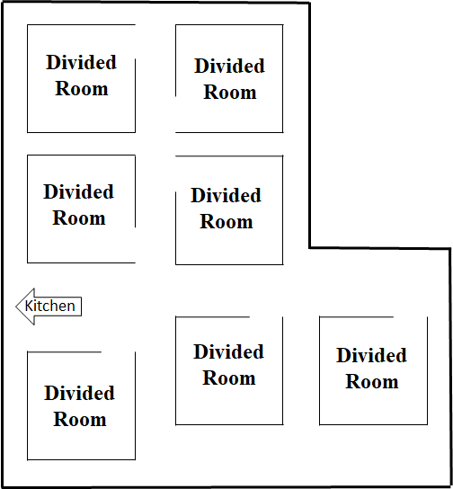
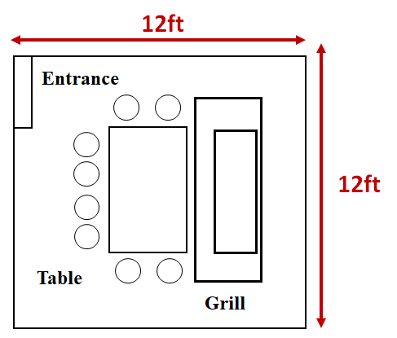
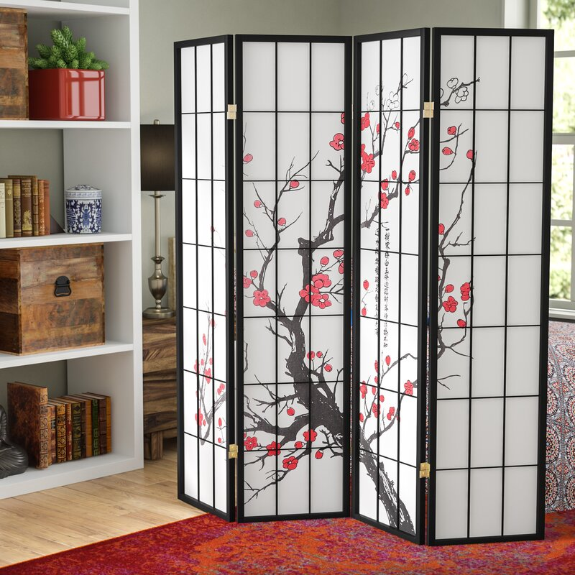
Restaurant reopening plans in accordance with all government regulations and with an emphasis on safety
Re-Opening
Private Rooms
Exclusive atmosphere while promoting health and safety. Each room includes a private grill and glass barrier around the grill for extra protection. The room is complete with Japanese art dividers.
Notes:
Split into 2.
Helen
Cash-flow from Omakase allows us to make necessary renovations, cash reserves, and temporal flexibility to re-open
When we re-open, we plan to prioritizie safety + rebranding, we will be utilizing private rooms + spatula.

Slide 17
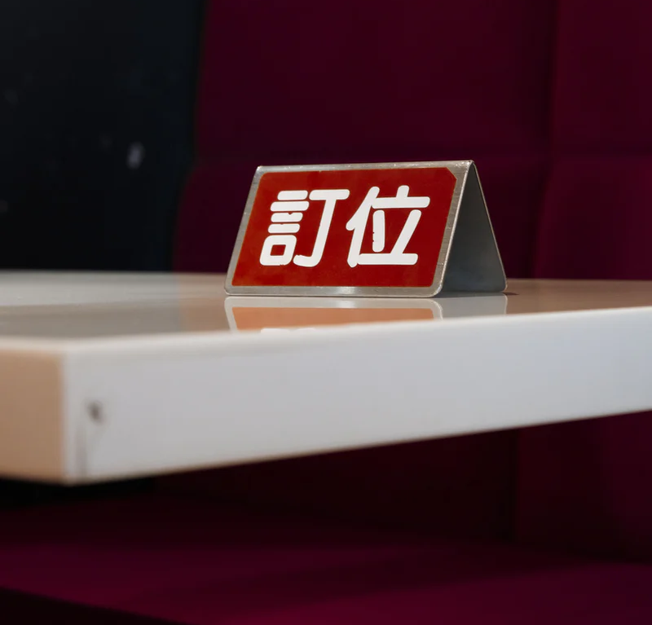
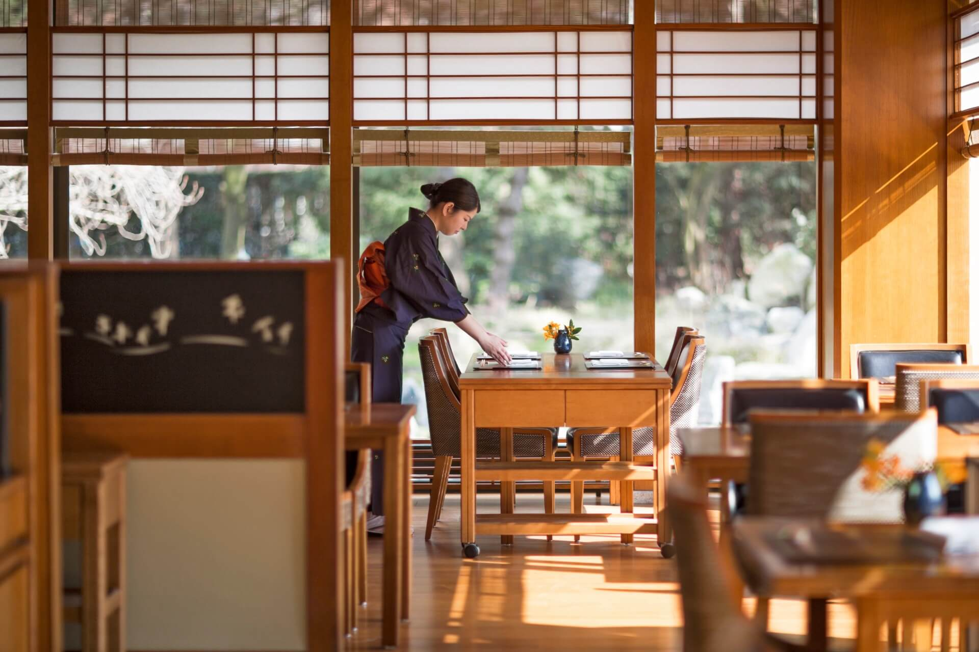
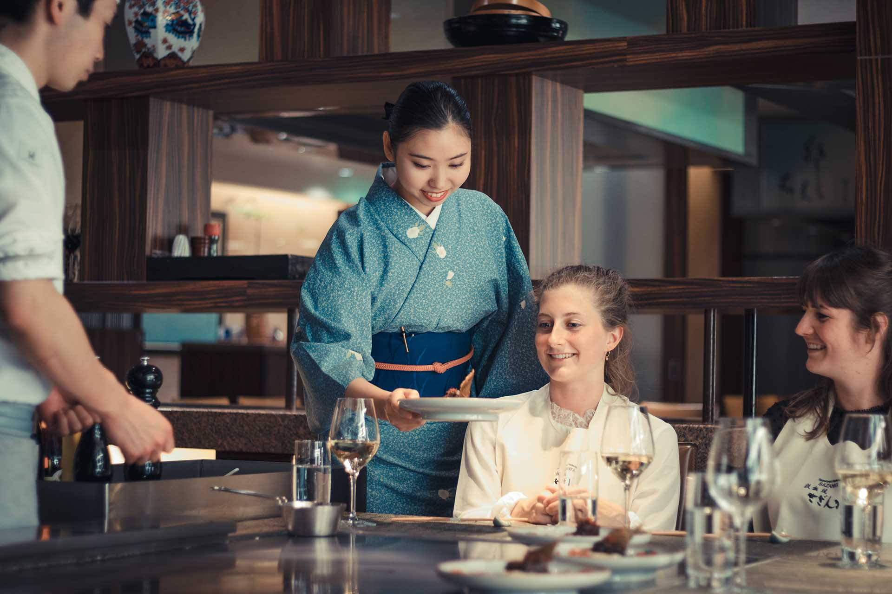
New dine-in operations focused on quality, experience, and high safety measures
Re-Opening
Reserve
Check-In
Experience
Given the uncertainty of COVID-19, in order to mitigate reopening risks, guests must make reservations in advance
This system will also help us assess demand and optimize our operations.
Upon arrival, hand sanitizer will be provided to guests at the entrance.
Guests must wear masks until seated.
Contact information will be asked for contact tracing purposes.
Self-assess for symptoms daily
complete hourly temperature checks, and training for disease prevention. Public transit is discouraged and chefs will use 5 ft spatulas to serve food.
Notes:
Bullet Paragraphs
Take out menu
Separate Slide fo menu
What was originally menu,
helen

Slide 18
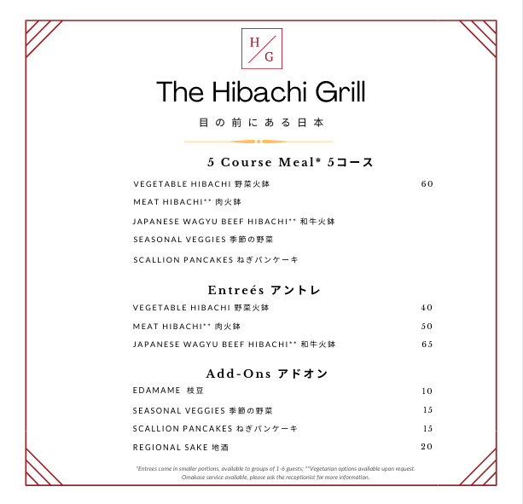
New dine-in operations focused on quality, experience, and high safety measures
Re-Opening
“Japan at Your Doorsteps”
Menu written in both Japanese and English to bring authenticity to our brand.
Accessible for both English and Japanese speakers.
Higher Prices
To ensure that Margaret’s business will be profitable, the prices are increased to increase margins.
Higher prices are justified with more exclusive and upscale atmosphere in addition to more premium
Our simplified menu in Japanese and English will bring you the authentic teppanyaki experience. Due to COVID-19 precautions, sushi has been removed temporarily.
5-Course Meal
Higher price for smaller portions.
Bundling conveys sense of value.
Hibachi Only
Removed sushi due to increased health concerns during COVID.
Ingredients used in sushi also have shorter shelf-life, contributing to potential loss via food waste.
Notes:
Bullet Paragraphs
Take out menu
Separate Slide fo menu
What was originally menu,
helen

Slide 19

People Over Profit: investment in restaurant talents and advancing career opportunities
Culture
Communication
Past employees will be given priority consideration for future positions, ideally returning to full employment levels by late Fall 2020.
To further show commitment to the employees, we recommend the owner to allocate her own salary to help her laid-off employees.
Notes:
1 Slide Each w/ Good Pictures.
Bullet everything

Slide 20

People Over Profit: investment in restaurant talents and advancing career opportunities
Culture
Career Advancement
Professional training will be available to prepare chefs for omakase services.
We will allocate up to $8000 per month to finance the training costs, provide in-training chefs with a weekly stipend.
Upon reopening, dine-in chefs will also receive a salary increase by $4/hr.
Notes:
1 Slide Each w/ Good Pictures.
Bullet everything

Slide 21

People Over Profit: investment in restaurant talents and advancing career opportunities
Culture
Employee Benefits
To ensure that all of our employees can arrive to work safely, we will provide carpool, housing stipends, and COVID-19 hazard pay to alleviate our employees’ stress in transitioning during this difficult time.
Notes:
1 Slide Each w/ Good Pictures.
Bullet everything

Slide 22

People Over Profit: investment in restaurant talents and advancing career opportunities
Culture
Team Building
To help our team build and stay connected during the COVID era, we will implement all expenses paid omakase practice sessions at employees’ homes, weekly virtual happy hours, and weekly virtual mental health support groups.
Notes:
1 Slide Each w/ Good Pictures.
Bullet everything

Slide 23
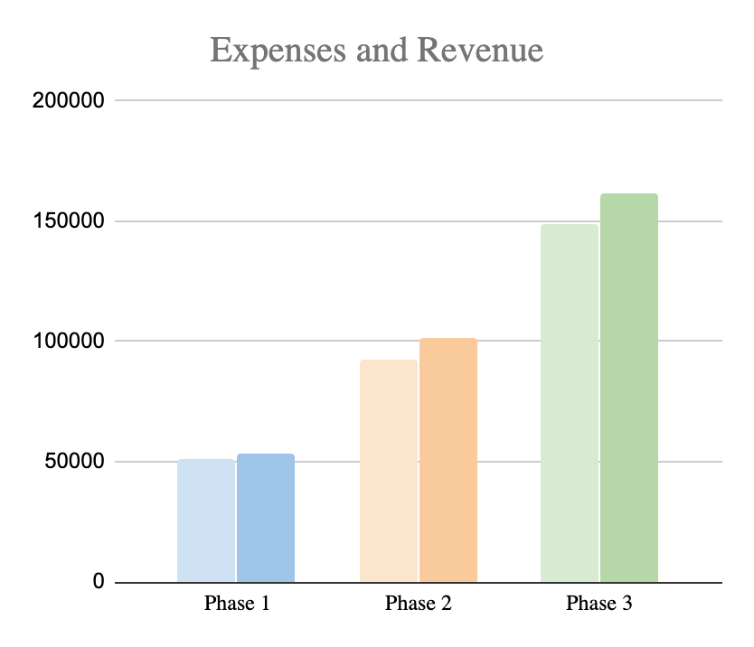
Financial Projections & Assumptions
Financials
Assumptions
Notes:
Rework financial
Split assumptions and synergy away
Add better assumptions
xyz

Slide 24
Financial Strategy & Synergy
Financials
Financial Strategy
Synergy
Monthly Fixed Cost of up to $16,300 for rent and utilities.
Number of shifts will be scaled based on customer demand.
Omakase break-even refers to being able to pay all chefs a minimum of $400 weekly.
In phase 3, chefs who are trained for Omakase can operate in dine-in settings as needed.
The simplified menu can also be optimized to create an economy of scale via better supply chain efficiencies.
Notes:
Rework financial
Split assumptions and synergy away
Add better assumptions
xyz

Slide 25
Risk Assessment and Solutions
Operations
Probability of Risk Occurring
Solutions & Mitigation
Low
High
A
Higher Rent/Utilities Than Expected
Lower Delivery Demand Than Expected
Lower Omakase Demand Than Expected
Lower Dine-In Demand Than Expected
Longer Restrictions Period Than Expected
C
B
Low
E
C
D
E
Severity of Risk
D
High
B
A
Notes:
Strategy Recap - Basically the strategy slide from the beginning
Risks then Implementation, improve the risks, ignore the implementation
xyz

Slide 26
Implementation Timeline
Operations
Implementation Timeline
Activity | Phase 1 | Phase 2 | Phase 3
 | Aug - Sept. 2020 | Sept - Fall 2021 | Fall 2021 +
 |  | Omakase Preparation Completed | Philadelphia Restaurant Restrictions Lifted
Website Design + Launch
Delivery/Pick-Up Service
Chef Enrichment Program
Omakase Service
Employee Housing Subsidy
Menu Redesign
Other Rebranding Initiatives
Dine-In Renovations
Dine-In Service
Notes:
Strategy Recap - Basically the strategy slide from the beginning
Risks then Implementation, improve the risks, ignore the implementation
xyz

Slide 27
Financial Appendix
Financials
Number of Employee Shifts
Chefs
Waiters
Delivery Drivers
Chefs-In-Training
Financial Analysis
Daily Delivery/Takeout
Weekly Omakase
Daily Occupancy
19
30
19
6
30
30
19
6
60%
30
30
75%
Phase 1
Phase 2
Phase 3
Break Even
Projected
Notes:
Rework financial
Split assumptions and synergy away
Add better assumptions
xyz

